Slide 1
18ECC205J ANALOG AND DIGITAL COMMUNICATION
1

Slide 2
UNIT I: What are we studying?
Analog Modulation
Base Band Modulation Schemes
  Amplitude Modulation DSBFC
    DSBSC, SSBSC, VSB
  Angle Modulation
    FM, PM
2

Slide 3
What is Communication?
Communication is a process of conveying or transferring message or information from one place to another place.
Examples of messages : Audio signals in speech transmissions, Picture (Video) signals in television transmissions and data (say text) signals in data transmission.
Types
. Line communication
. Radio communication
3

Slide 4
Block Diagram of Communication System
4

Slide 5
The communication system consists of three basic components.
1.Transmitter 2.Transmission media 3.Receiver
Transmitter is the equipment which converts physical message, such as sound, words, pictures etc., into corresponding electrical signal.
Receiver is an equipment which converts electrical signal back to the physical message.
Channel may be either transmission line or free space, which provides transmission path between transmitter and receiver.
5

Slide 6
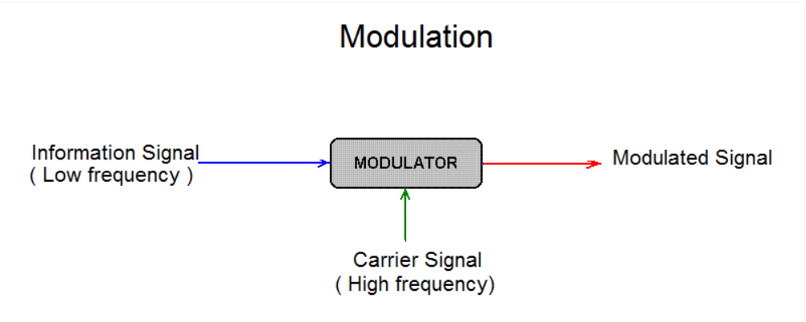
Modulation: Modulation is defined as the process by which some characteristics (i.e. amplitude, frequency, and phase) of a carrier is varied in accordance with instantaneous value of modulating signal
Carrier Signal : High frequency signal to carry the message. Its frequency will be in the range of MHz.
Message/ Modulating Signal : Contains the information to be transmitted. Its frequency will be in the range of 20Hz to 20KHz.
Demodulation is the reverse process of modulation, which is used to get back the original message signal. Modulation is performed at the transmitting end whereas demodulation is performed at the receiving end.
6

Slide 7


NEED FOR MODULATION
1.Multiplexing- It helps in transmitting a number of messages simultaneously over a single channel and therefore the number of channels needed will be less. This reduces the cost of installation and maintenance of more channels. If transmitted without modulation,the several message over a single channel will interfere with one another.
2.Practicability of antenna - To reduce antenna height.
If f=5KHz, then height of the antenna
If f=10MHz, then height of the antenna
=15m
3.Narrowbanding
7

Slide 8
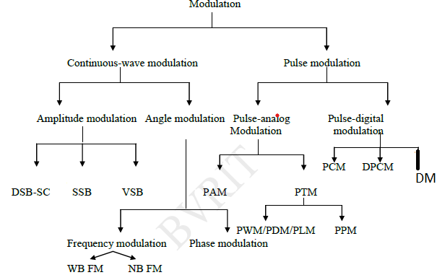
Types of Modulation
8

Slide 9
AMPLITUDE MODULATION
A modulation process in which amplitude of the carrier signal is varied in accordance with instantaneous value of the modulating signal is known as amplitude modulation.
Representation of Amplitude modulated signal:
Carrier signal is mathematically denoted as e(t) = E_{c} cosω_{c}t,
E_{c} = Amplitude of the carrier signal, ω_{c} = angular frequency of the carrier signal(rad/sec).
Modulating signal is mathematically denoted as f(t) = E_{m}cos⍵_{m}t,
E_{m} = Amplitude of the carrier signal, ⍵_{m} = angular frequency of the carrier signal(rad/sec).
After AM, Amplitude of carrier signal ,E _{c} = E_{c} + f(t)
, eAM (t) = E_{c} cosω_{c}t+ f(t ) cosω_{c}t
carrier sidebands
eAM(t) = [E_{c} + f(t)] cosω_{c}t
9

Slide 10
Substitute f(t) = E_{m}cos⍵_{m}t eAM(t) = E_{c} cosω_{c}t+ E_{m}cos⍵_{m}t cosω_{c}t
= E_{c} cosω_{c}t(1+ E_{m}/E_{c} cos⍵_{m}t )
Modulation index, E_{m}/E_{c} = m_{a} (Ratio of modulating voltage to carrier voltage)
eAM(t) = E_{c} cosω_{c}t(1+ m_{a} cos⍵_{m}t )
eAM(t) = E_{c} cosω_{c}t+ m_{a} E_{c} cosω_{c}t cos⍵_{m}t , Apply cos A cos B formula, Then we get
eAM(t) = E_{c} cos⍵_{c}t + m_{a} E_{c}/2 [cos(⍵_{c}+⍵_{m} )t + cos (⍵_{c}- ⍵_{m} )t]
Carrier signal USB LSB
eAM(t)=Amplitude modulated signal
10

Slide 11
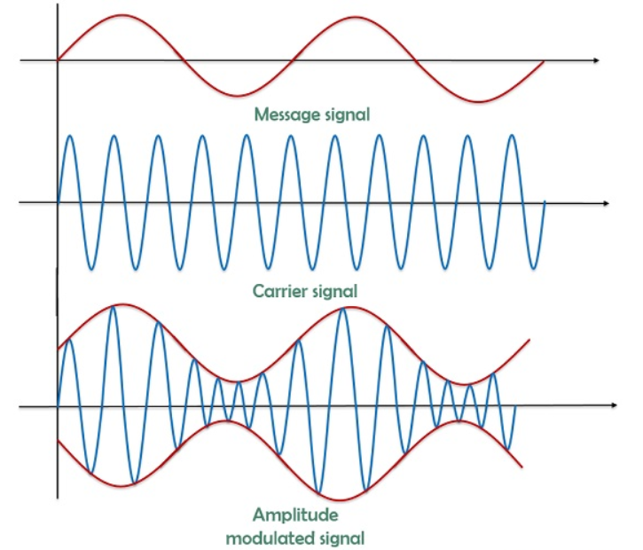
Time domain representation of DSB-FC
11

Slide 12
Frequency Spectrum of DSB -FC
Bandwidth = Highest frequency – Lowest frequency
= ( fc + fm) - ( fc - fm) = 2f_{m} Ec maEc/2 maEc/2 f_{c}-f_{m} f_{c} f_{c}+f_{m f} LSB USB BW=2f_{m}
12

Slide 13
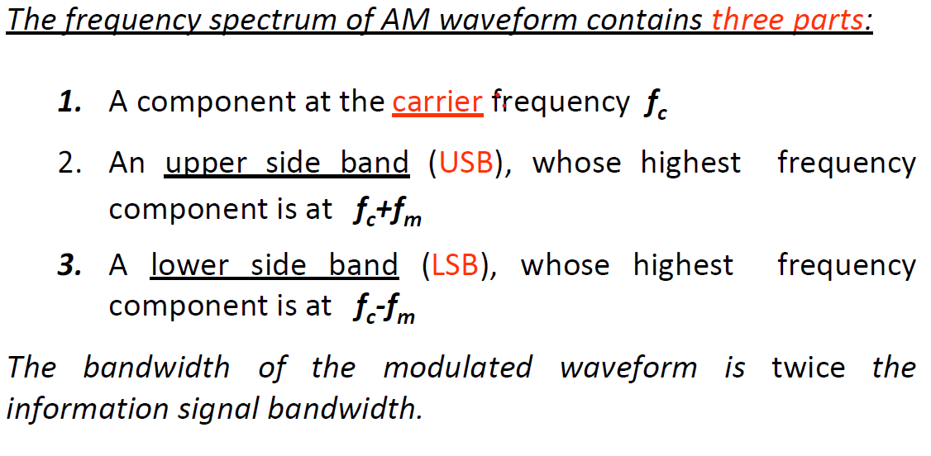
Frequency spectrum of DSB FC
13

Slide 14
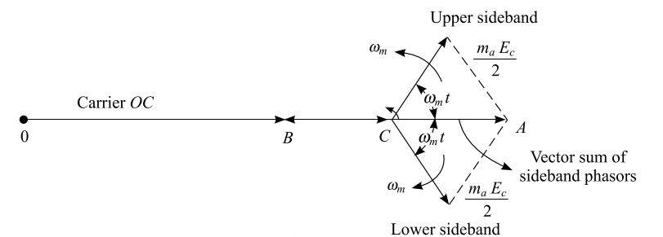
Phasor Diagram of DSB FC
14

Slide 15
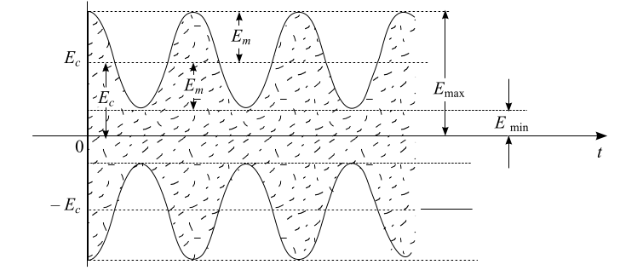
Waveform of DSB FC
15

Slide 16
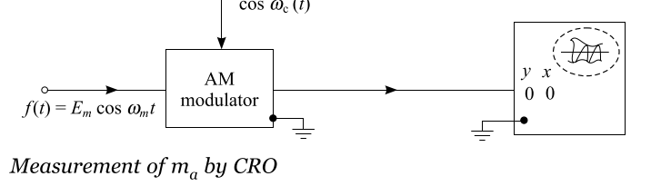
Measurement of ma by CRO
16

Slide 17
Measurement of m_{a} by CRO
From the Waveform of DSB FC
E_{m}=E_{max}- E_{c}=E_{c}- E_{min}
2E_{m}=E_{max}- E_{min}
E_{m} = (E_{max}- E_{min} ) /2
E_{c}=E_{max}- E_{m}=E_{min}+E_{m}
E_{c}=E_{max}-[(E_{max}- E_{min} ) /2]=( E_{max}+ E_{min} ) /2
m_{a} =Em/Ec
m_{a} =(E_{max}-E_{min})/(E_{max}+E_{min})
17

Slide 18
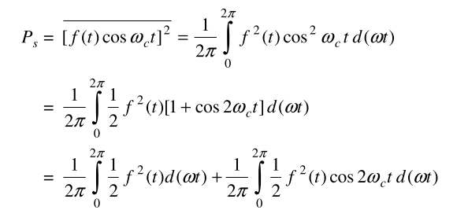

Total Radiated Power and Current of DSB FC
eAM(t) = A cosω_{c}t+f(t) cosω_{c}t A=Amplitude of carrier signal
carrier sidebands
Carrier power(Pc ):
Pc= = A²/2 = Mean square value of carrier signal
Side band power (P_{S}) :
.
The second integral is filtered out by BPF centered around ω_{c} .
P_{S}= , = Mean square value of modulating signal
P_{S}= P_{LSB}+P_{USB} =Em²/4
Total Radiated Power: P = Pc + P_{S ,} E_{m}/E_{c} =m_{a}
18

Slide 19

Total Radiated Power and Current of DSB FC
E_{m =} m_{a} A
Side band power P_{S}= m_{a}² A²/4
Total power P = Pc+P_{S}
P= Pc+ m_{a}²P_{c}/2
=P_{c} [1+(m_{a}²/2)]
P =1.5P_{c} m_{a} =1 for Critical modulation
Total current
I = I_{c}
19

Slide 20
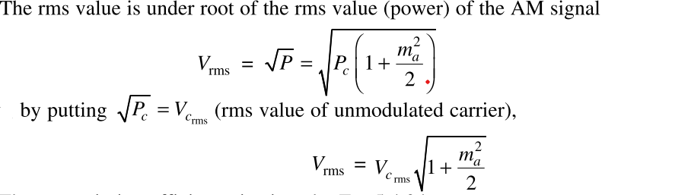
rms value of Modulating Signal
rms value:
20

Slide 21
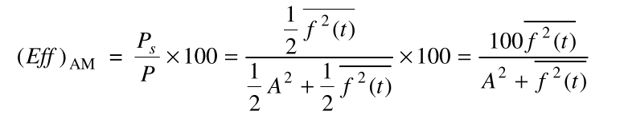


Transmission Efficiency
The amount of useful message power Ps present in AM is expressed by a term called transmission efficiency denoted by Eff.It is defined as percentage of total power contributed by the sidebands.
Efficiency =
Dividing numerator and denominator by A²/2 We get,
Eff = m_{a}²/(2+ m_{a}² ) we know Em/A = ma
m_{a} =1 , 100% modulation or Critical modulation
Eff = (1/3) x100 =33.3%
21

Slide 22
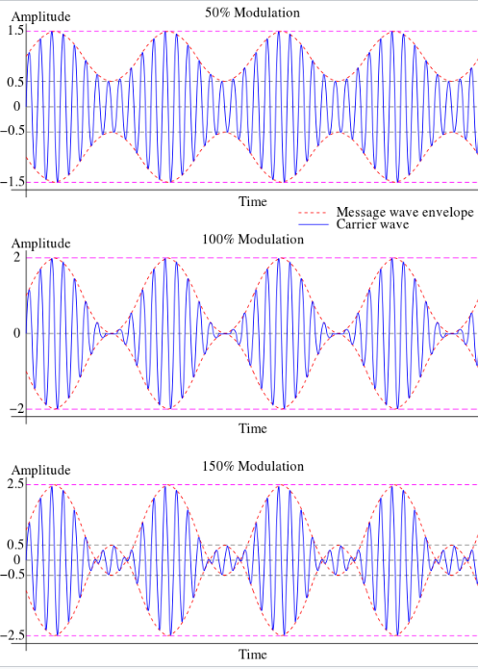
Different types AM with respect to modulation index ma
ma <1 Under modulation
ma =1 Critical modulation
ma > 1 Over modulation Practically,we prefer under modulation condition only.That is
ma <1.Em<Ec
22

Slide 23

Types of Amplitude Modulation
1.DSB SC (Double Sideband Suppressed Carrier)
2.SSB SC (Single Sideband Suppressed Carrier)
3.VSB (Vestigial Side Band modulation)
1.Reprsentation of DSB SC (Double Sideband Suppressed Carrier)
Product Modulator
cosω_{c}t
f(t) e_{DSB-SC}(t)= f(t) cosω_{c}t
f(t) = cos⍵_{m}t
e_{DSB-SC}(t)= cos⍵_{m}t cosω_{c}t = 1/2[cos(⍵_{c}+⍵_{m} )t + cos (⍵_{c}- ⍵_{m} )t] ,It contains only two sidebands .There is no separate carrier signal.
Bandwidth BW= ( fc + fm) – (fc - fm) =2f_{m}
% of power saving =(P –PS)/P = 66.67%, Transmission efficiency =100%
23

Slide 24


SSB-SC
Filter method for generating SSB-SC
cosω_{c}t
f(t)
e_{DSB-SC}(t)= f(t) cosω_{c}t
f(t) = cos⍵_{m}t
The output of Product modulator is given by
e_{DSB-SC}(t)= cos⍵_{m}t cosω_{c}t, It contains only two sidebands .
BPF will be used to eliminate one of the sidebands. So e_{SSB-SC}(t) contains only one sideband either USB or LSB.
e_{SSB-SC}(t) = cos (⍵_{c}- ⍵_{m} )t only Lower sidebands in this case based on tuning of BPF
BW= fc - ( fc-fm) = f_{m}
% of power saving =83.33%, Transmission efficiency =100%
24

Slide 25

VSB
In Vestigial sideband modulation, the desired sideband is allowed to pass completely. Whereas just a small portion of the undesired sideband is also allowed. The transmitted vestige of the undesired sideband components for the loss of the desired sideband. Mainly used for Television(TV) signal transmission.
Generation of VSB signal using filter method
cosω_{c}t
f(t)
VSB
DSB-SC
Η(ω)
25

Slide 26
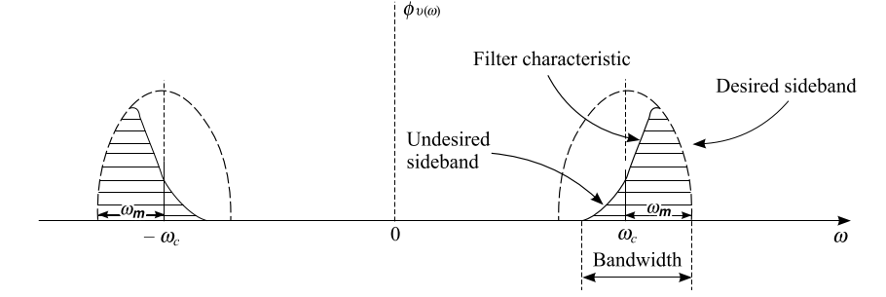
VSB Filter Characteristics
26

Slide 27

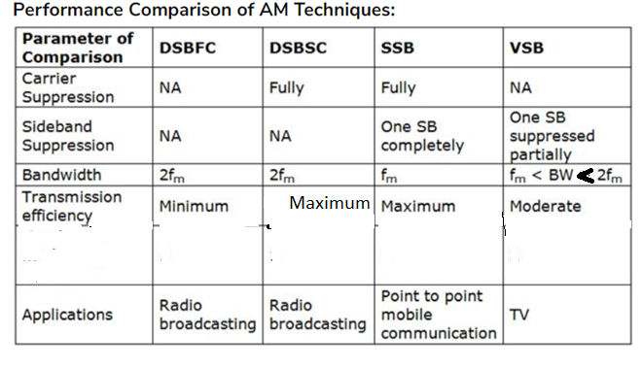
Comparison of Different Amplitude modulation Techniques
27

Slide 28
Frequency spectrum of DSB-SC&SSB-SC
Ec
maEc/2 maEc/2
DSB-SC f_{c}-f_{m} f_{c} f_{c}+f_{m f}
Ec
maEc/2 maEc/2
SSB-SC f_{c}-f_{m} f_{c} f_{c}+f_{m f}
28

Slide 29
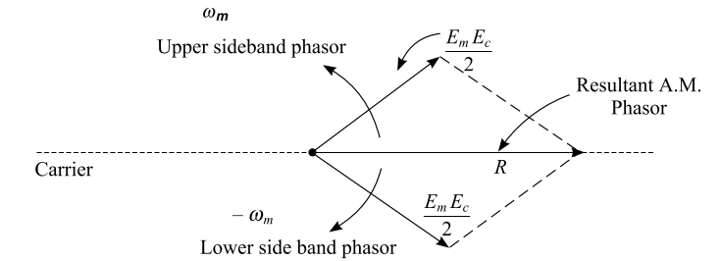
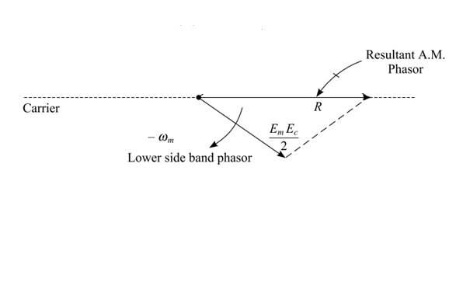
Phasor Diagram of DSB-SC&SSB-SC
29

Slide 30
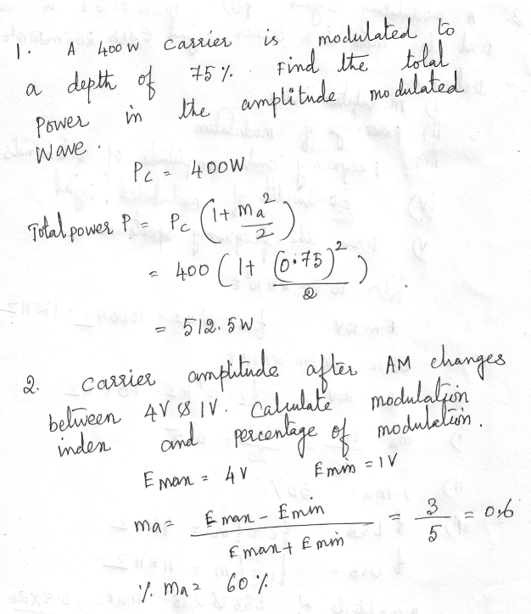
Problems
30

Slide 31
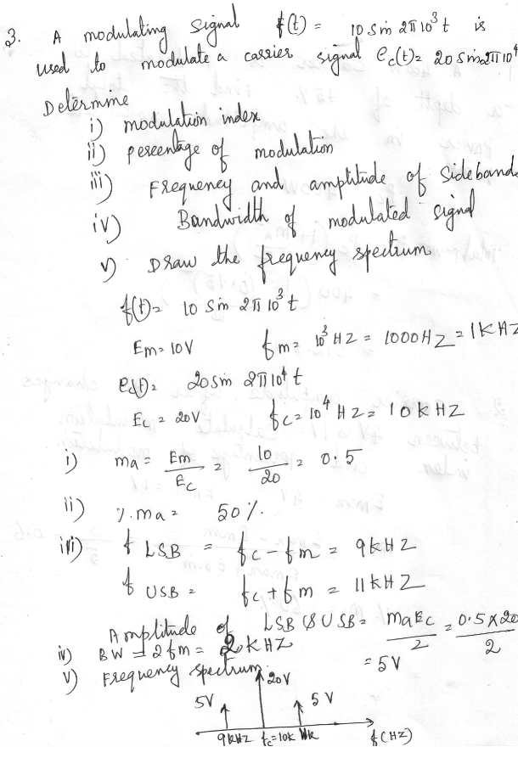
Problems
31

